Slide 1

SESHADRI RAO GUDLAVALLERU ENGINEERING COLEGE
(An Autonomous Institute permanently affiliated to JNTUK , Kakinada)
Department of Electronics and Communication Engineering
Braille-Based IoT Home Automation for
Multi-Disability Empowerment
Batch No : C5
Batch Members:
N. Manikanta Raghava — 23485A0424
M. Jahnavi — 22481A04F5
N. Venkata Siva Prasanth — 23485A0423
Md. Habeeb Pasha — 22481A04F8
Guided by:
Mr. V. Vittal Reddy
(Associate Professor)

Slide 2
Objectives of the Project Work
Develop a low-cost, accessible Braille-based IoT system that empowers visually and speech-impaired individuals to control home appliances independently, providing real-time confirmation through haptic feedback and audio signals to ensure accuracy and ease of use.
Implement an intelligent emergency alert system that detects hazards like fire and instantly notifies caregivers via Blynk IoT cloud push notifications ensuring continuous safety and reliability during critical situations.

Slide 3
Abstract of the Project Work
This project presents a Braille-based IoT home automation system designed to assist visually and speech-impaired individuals. Built on ESP32 microcontrollers, the system employs a custom persistent TCP protocol to transmit commands from a portable six-dot Braille keypad to a central appliance controller. Accessibility is ensured through simultaneous haptic (vibration) and auditory feedback for the user, while an SSD1306 OLED display provides visual status for caregivers. Additionally, the system integrates flame sensors and Blynk IoT connectivity to provide real-time safety alerts, offering a secure, reliable, and inclusive alternative to conventional smart home controls.

Slide 4
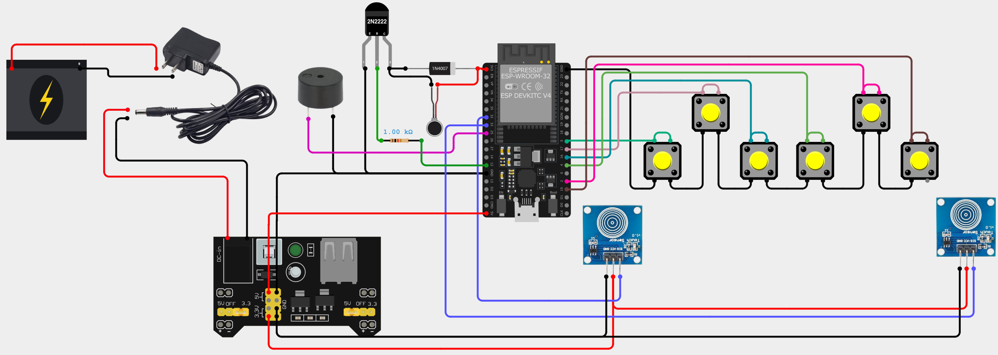
Hardware Wiring Diagram
Remote Module

Slide 5
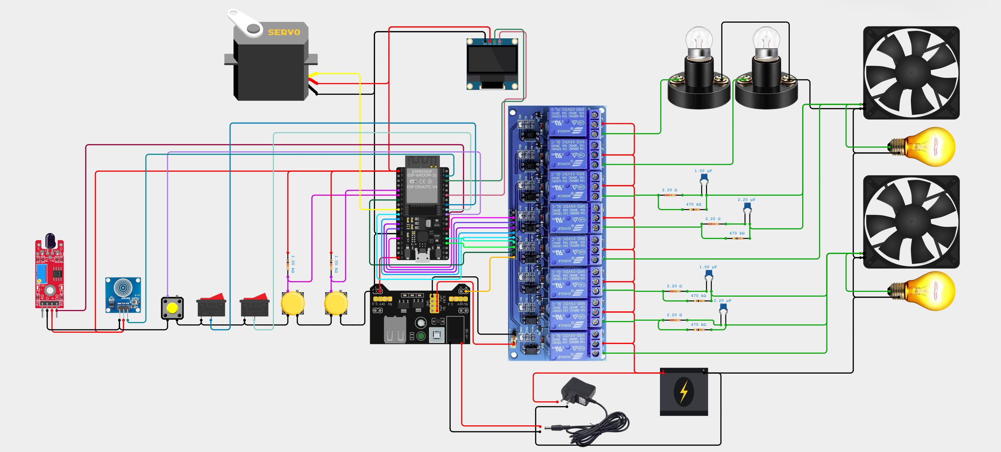
Hardware Wiring Diagram
Appliance Control Module

Slide 6
Flow chart
Braille Keypad Module
Power ON
Initialize sensors & Wi-Fi
Read inputs
Valid Braille Input
Send appliance command
No
Is Feedback Received from TCP
Yes
Play Feedback
Emergency
Send ACK or STOP
Appliance Control Module
S/E/C/W
feedback pattern →
Is Command Received
Initialize sensors, Wi-Fi & Display
Power ON
Listen TCP for commands
Yes
Decode command
Execute command & give Feedback
No
‘F’ fire alert
feedback pattern →
Update display
Is Flame detected
Monitor Flame sensor
Yes
Emergency alert
No

Slide 7
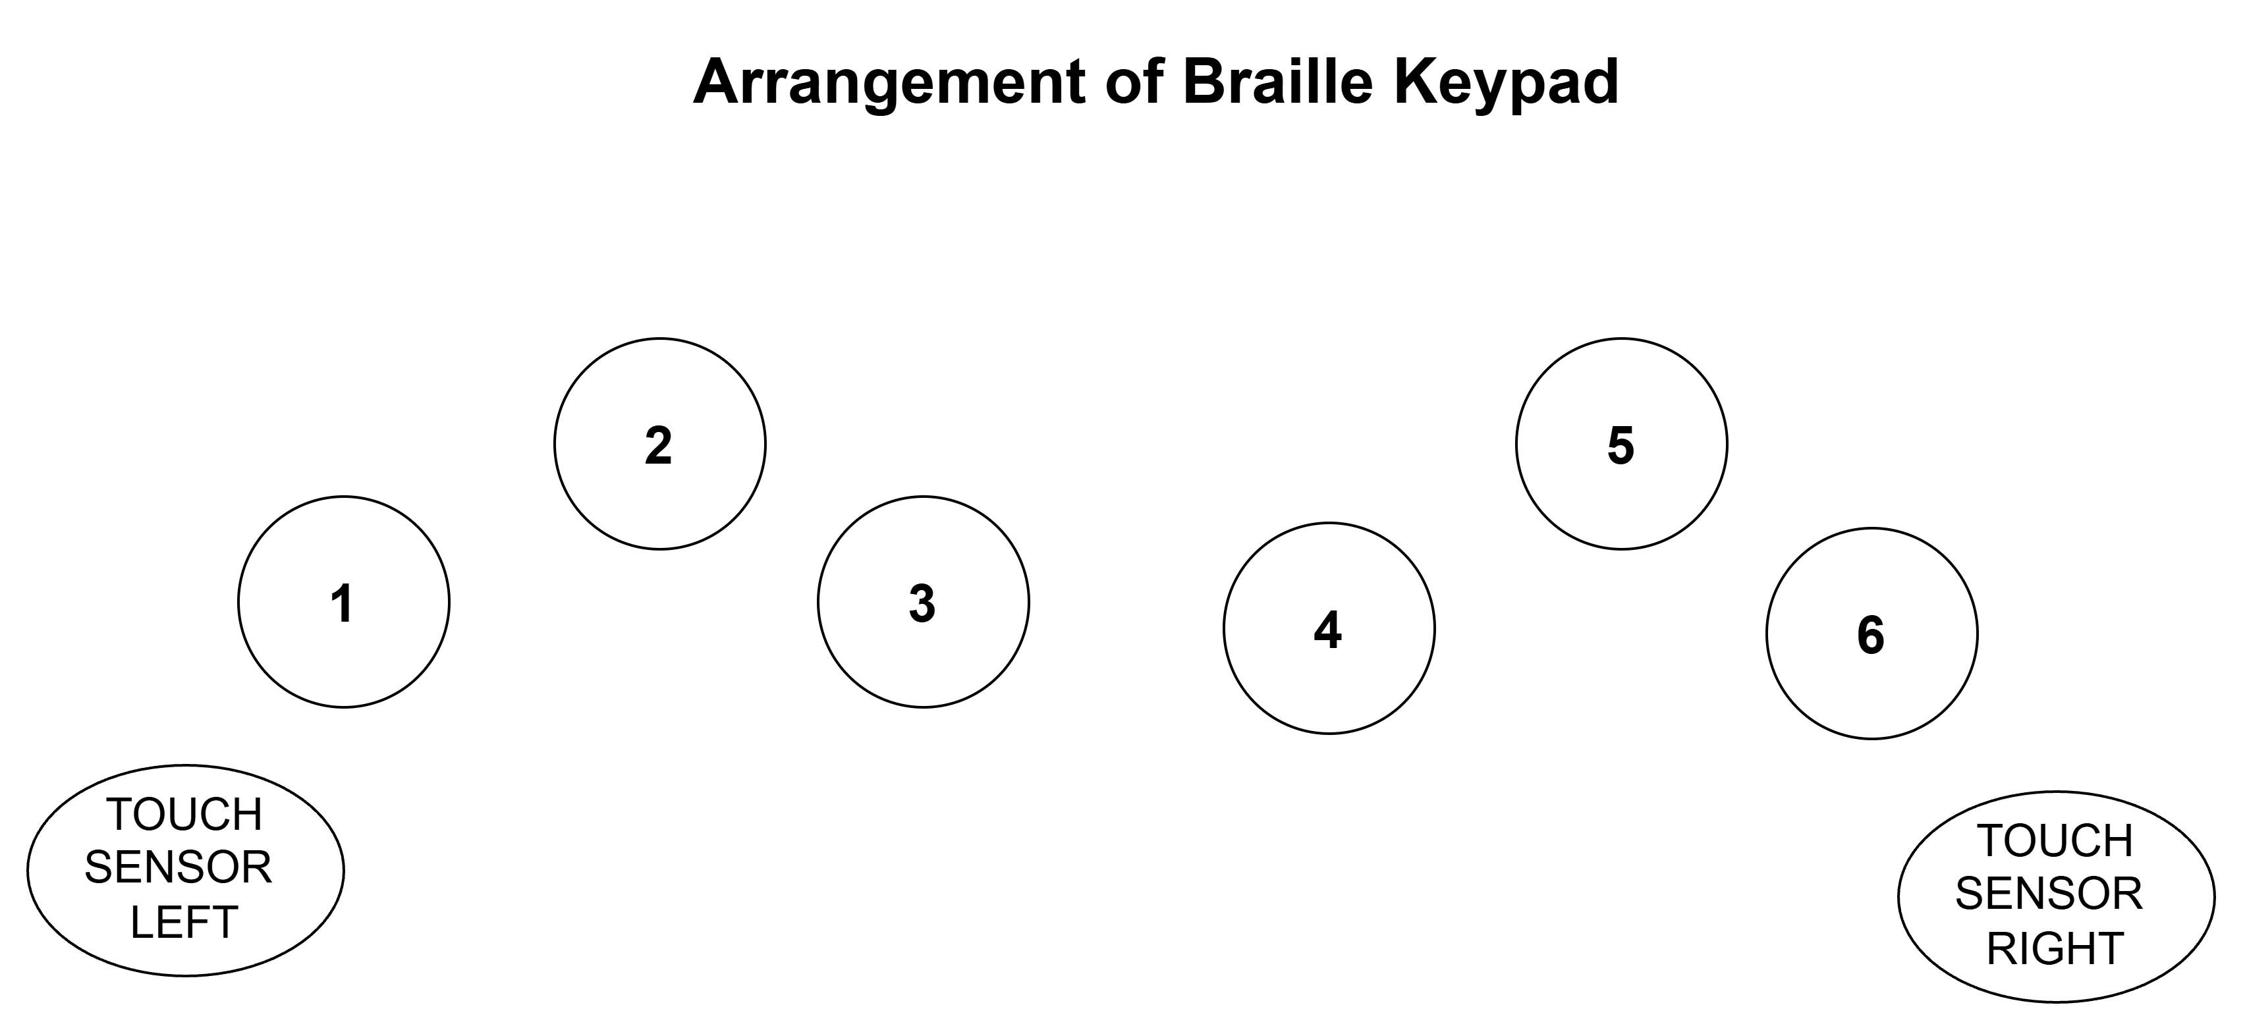
Module Communication & Braille Recognition
System Connectivity
Lookup Table & Pattern Mapping
Network Topology
The brailleMap[] stores decimal equivalents of Braille dot patterns to match physical input to characters.
Operates on a Master/Slave model where the Remote Module (TCP Client) connects to the Appliance Module (TCP Server) on Port 7890 .
Dual-Mode Wi-Fi
// Braille Lookup Table (A-Z)
Utilizes WIFI_AP_STA mode to allow either connection via a router or direct peer-to-peer (AP) connection.
const byte brailleMap[] = {
1, 3, 9, 25, 17, 11, 27, 19, 10, 26, // A-J
5, 7, 13, 29, 21, 15, 31, 23, 14, 30, // K-T
37, 39, 58, 45, 61, 53 // U-Z
};
The Braille Recognition Engine
The system uses bitwise logic to convert physical inputs from a 6-dot cell into a binary pattern.
Mode Logic: Alphabet vs. Number
// Bitwise Pattern Detection
// Mode Differentiation Logic
byte pattern = 0;
for (int i=0; i<6; i++) {
if (digitalRead(btnPins[i]) == LOW)
pattern |= (1 << i); // Map buttons to binary bits
}
if (tR) detectedChar = brailleChars[i];
// Right touch = A-Z
else if (tL)
detectedChar = (i < 9) ? (i + 1) + '0' : '0';
// Left touch = 1-0
Touch Sensors:
• Left (tL): Number mode (1-0)
• Right (tR): Alphabet mode (A-Z)
• Both: Command confirmation

Slide 8
Supported Commands & Feedback Patterns
Appliance Command Set
Haptic & Audio Feedback Timing
L1 / L2
Toggles light relays on Pins 13 and 12
The system ensures immediate confirmation for visually impaired users.
S
Success ('S')
Fxy
Controls Fan x (Room 1/2) at Speed y (0–4)
400ms pulse for confirmed actions
OPN
Rotates door servo to 90°; auto-closes after 5 seconds
E
Error ('E')
800ms long pulse for invalid commands
ALL1 / ALL0
Master override for all devices
C
Correct Password ('C')
Command Parsing Implementation
5 short pulses (400ms ON / 200ms GAP)
W
Wrong Password ('W')
if (inputBuffer == "L1") {
l1State = !l1State;
digitalWrite(RELAY_L1, l1State);
preferences.putBool("l1", l1State);
Blynk.virtualWrite(V1, l1State);
response = 'S';
}
else if (inputBuffer.startsWith("F")) {
int r = inputBuffer.charAt(1) - '0';
int s = inputBuffer.charAt(2) - '0';
if (r==1) { fan1State=s; setFan1Speed(s); }
}
5 long pulses (800ms ON / 200ms GAP)
Feedback Function Implementation
void triggerFeedback(char type) {
if (type == 'S') { // 400ms
digitalWrite(vibMotor, HIGH);
delay(400);
digitalWrite(vibMotor, LOW);
}
else if (type == 'C') { // 5× short
for (int i=0; i<5; i++) {
digitalWrite(vibMotor, HIGH);
delay(400);
digitalWrite(vibMotor, LOW);
if (i<4) delay(200);
}
}
}

Slide 9
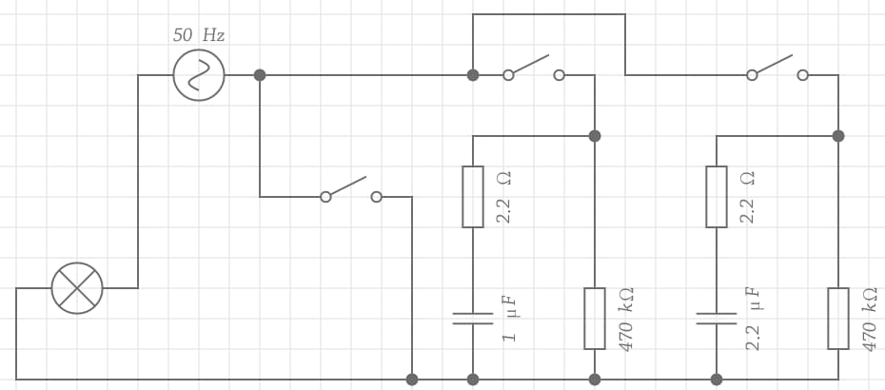
Capacitive Fan Regulator Design
Design Parameters
Fan Speed Control Matrix
Load Analysis
Speed | Relay 1 | Relay 2 | Relay 3 | Ceff
0 (OFF) | — | — | — | 0µF
1 (Low) | ON | — | — | 1.0µF
2 (Med-Low) | — | ON | — | 2.2µF
3 (Med-High) | ON | ON | — | 3.2µF
4 (Max) | — | — | ON | Bypass
Designed for a 33W load as it is listed under fan specifications.
Capacitor Selection
C₁ = 1.0µF and C₂ = 2.2µF (Non-polarized)
RC Time Constant Calculations (Discharge Safety)
Bleeder resistors (R = 470kΩ) are used for safety.
Step 1: Calculate τ (Tau)
Speed Control Implementation
For C₁ (1.0µF): τ = 470kΩ × 1.0µF = 0.47 seconds
void setFan1Speed(int speed) {
if (speed == 0) {
digitalWrite(RELAY_F1_1, RELAY_OFF);
digitalWrite(RELAY_F1_2, RELAY_OFF);
digitalWrite(RELAY_F1_3, RELAY_OFF);
} else {
digitalWrite(RELAY_F1_1,
(speed==1 || speed==3) ? RELAY_ON : RELAY_OFF);
digitalWrite(RELAY_F1_2,
(speed==2 || speed==3) ? RELAY_ON : RELAY_OFF);
digitalWrite(RELAY_F1_3,
(speed==4) ? RELAY_ON : RELAY_OFF);
}
Blynk.virtualWrite(V3, speed);
}
For C₂ (2.2µF): τ = 470kΩ × 2.2µF = 1.03 seconds
Step 2: Safe Discharge Time (5τ)
Full discharge occurs after 5τ
C₁ Result: 0.47s × 5 = 2.35 seconds
C₂ Result: 1.03s × 5 = 5.15 seconds
Circuit diagram:
Relay 1
Relay 2
Relay 3
Load
(light /fan)
Resistors
Capacitors
R₁, R₃ = 220kΩ (¼W)
C₁ = 1.0µF, 400V (cb22 105j400v)
R₂, R₄ = 2.2Ω (1W)
C₂ = 2.2µF, 400V(cb22 225j400v)

Slide 10
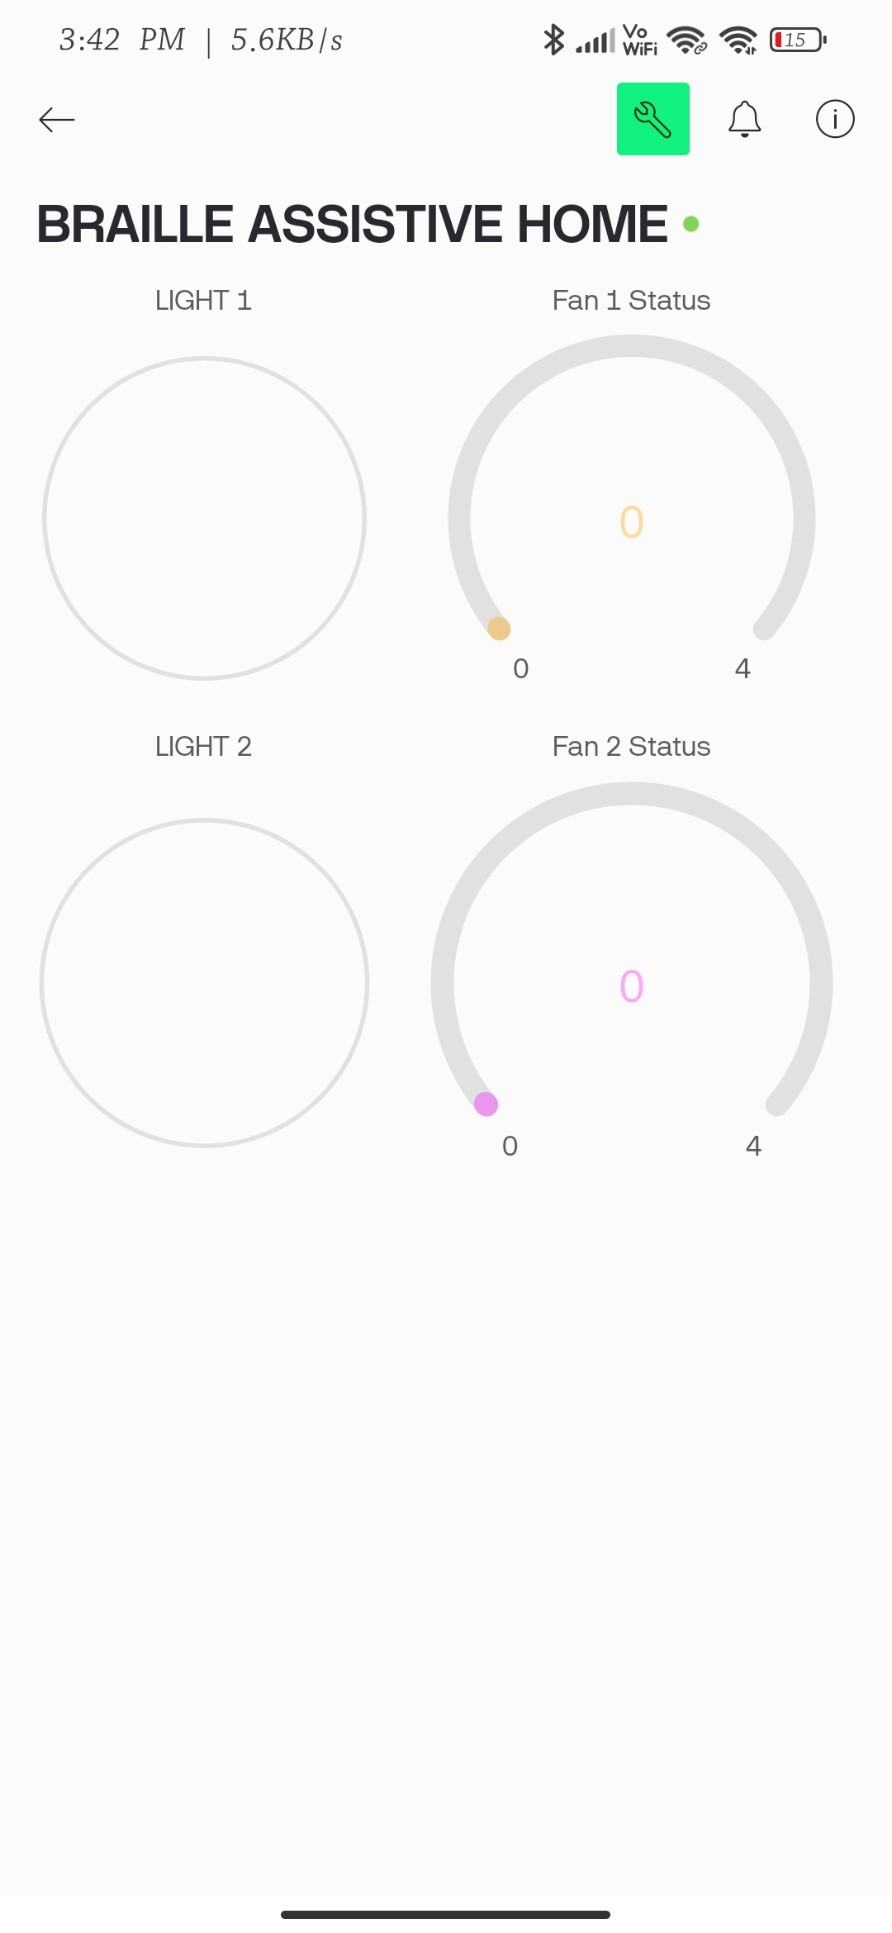
IoT Integration & Safety Systems
Blynk Virtual Pin Mapping
Safety System Logic
The system syncs hardware states to the cloud for remote monitoring.
Fire Detection
Virtual Pin | Device Assignment | Data Range
V1 | Light 1 Status | 0 (OFF) – 1 (ON)
V2 | Light 2 Status | 0 (OFF) – 1 (ON)
V3 | Fan 1 Speed | 0 – 4
V4 | Fan 2 Speed | 0 – 4
Flame sensor on Pin 4 detects hazards and triggers alerts every 1000ms.
Human-in-the-Loop Verification
ACK (Both Sensors): Confirms emergency, opens door, and sends Blynk notification
STOP (One Sensor): False alarm cancellation
Validation
Blynk Synchronization Code
User must hold sensor(s) for 2000ms to prevent accidental triggers.
// Fire Detection Loop (Active HIGH)if (digitalRead(FLAME_PIN) == HIGH) {
if (!fireActive) {
fireActive = true;
updateOled("!! FIRE !!");
}
if (millis() - lastFireMsg > 1000) {
lastFireMsg = millis();
activeClient.print('F'); // Alert remote
}
}
// ACK: Confirmed Emergencyif (inputBuffer == "ACK") {
fireActive = false;
doorServo.write(90); // Open door
Blynk.logEvent("fire_alert",
"Fire Alarm Confirmed!");
}
// Hardware → Cloud (State Updates)if(Blynk.connected()) {
Blynk.virtualWrite(V1, l1State);
Blynk.virtualWrite(V2, l2State);
Blynk.virtualWrite(V3, fan1State);
Blynk.virtualWrite(V4, fan2State);
}
// Cloud → Hardware (Control Commands)
BLYNK_WRITE(V1) {
l1State = param.asInt();
digitalWrite(RELAY_L1, l1State);
}
Emergency Response Implementation
Password Logic ("1010"): Touch + button → “1” otherwise “0”2-second hold on the button clears the input while long touch on touch sensor submits the password.
Table 10: Blynk IoT integration and safety system architecture
Braille-Based IoT Home Automation

